Slide 1
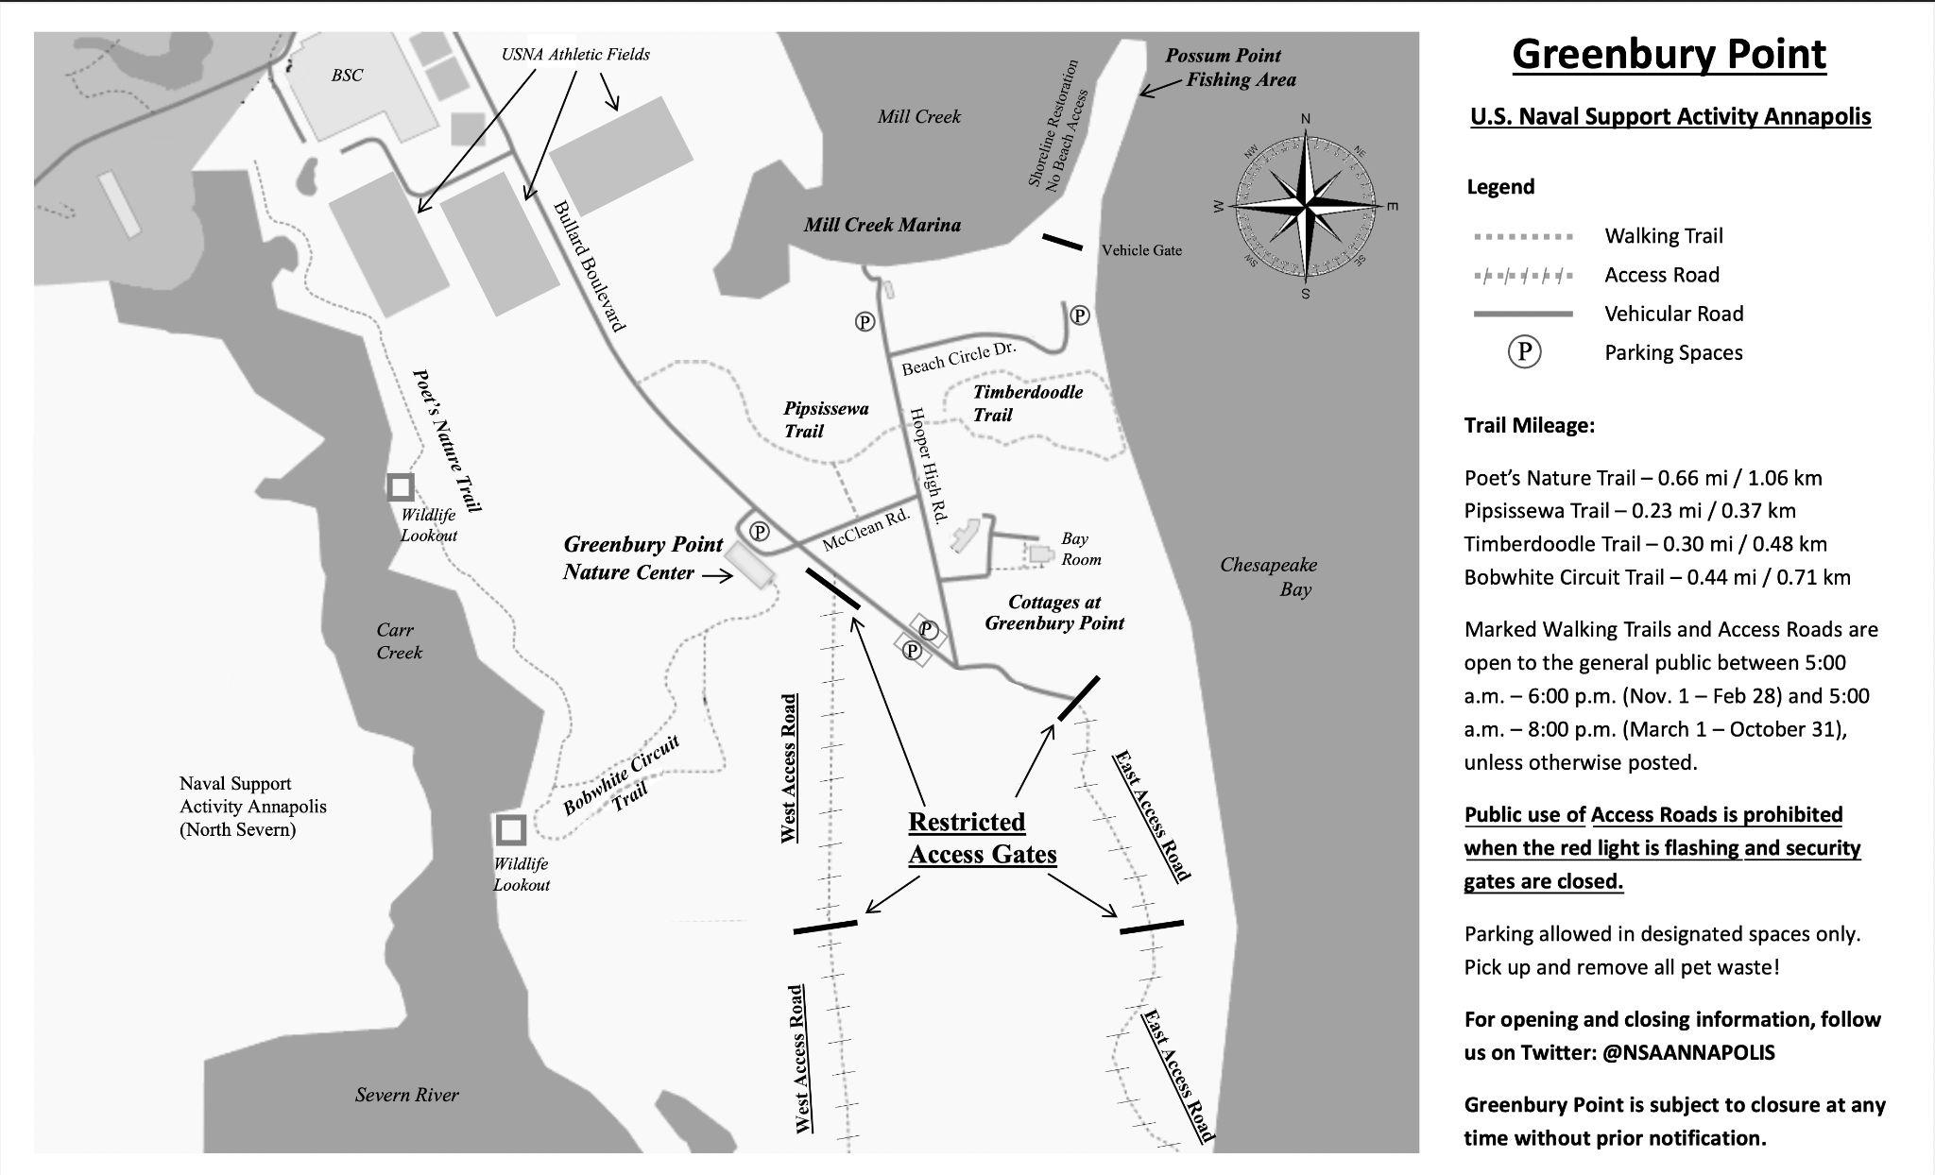
GREENBURY POINT PUBLIC ACCESS SCHEDULE
(February & March 2025)
Possum Point
Public Access Schedule:
Walking Trails & Possum Point Open: Daily
East & West Access Roads Open: February: 1, 2, 3, 7, 9, 10, 14, 15, 16, 17, 21, 23, 24, 28
March: 1, 2, 7, 8, 9, 10, 16, 21, 23, 28, 30
PUBLIC ACCESS SCHEDULE SUBJECT TO CHANGE AT ANY TIME WITHOUT PRIOR NOTIFICATION
Notes:
Summary:
Trails are not in the USNA Shooting Range’s Surface Danger Zone (SDZ), and are open daily (0500-2000 Mar-Oct; Nov-Feb 0500-1800). They’re a viable alternative to the gravel/dirt access roads.
Access Roads are mostly in the SDZ; therefore, NSAA closes the access roads [and their gates] on Greenbury Point on those days USNA scheduled shooting. Range ops incur a full day closure for Greenbury Point; unfortunately, NSAA does not have the manpower to clear all of Greenbury Point for portions of the day.
Access roads are regularly open on Sunday & Monday for walking, pending range activity. We also actively work with USNA Range Ops to open during Holiday weekends and longer holiday periods [ie, Christmas]. We post this onsite & on NSAA social media (FB & Twitter) for the public, and are easily referable (we post the attached map).

Slide 2
